Slide 1




DATA
GOVERNANCE

Slide 2



Table of
Contents
01
Introduction
02
Benefits of Data governance
03
Building data governance
04
Main characteristics
05
Goals
06
Challenges
07
Conclusion

Slide 3





Data Governance
Example
refers to a complete set of processes and policies and people as well for ensuring effective data management.
It’s very efficient and also enables an organization to achieve any specific goals
Data governance is not data management as data governance is a core component of data management.

Slide 4


Benefits of
Data governance
Borcelle Company
Basic understanding of data:
Data governance provides an overall view and provides common terminology and helps in retaining the flexibility of the business.
Improves data quality:
Complete and Correct data helps in achieving something perfectly. Data governance makes it easy as the plan created with data governance results in data correctness, completeness, and consistency.
Data Map :
Data governance provides an advanced ability to understand location data-related entities, which helps in data integration.

Slide 5

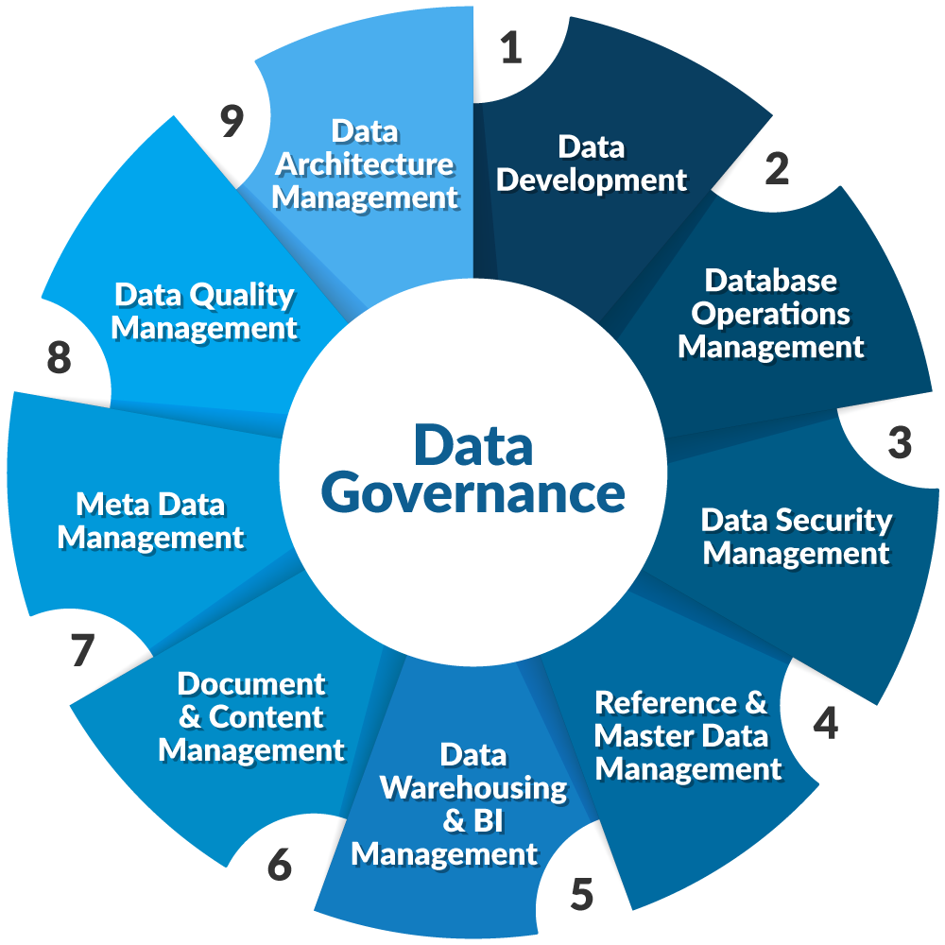

Building data governance
The DAMA-DMBOK can serve as a valuable resource to create a data governance framework for your organization.
It can help you establish a comprehensive
and consistent approach to data management
across different teams and verticals,
preventing data silos and facilitating data integration.

Slide 6


Main characteristics
of data governance
Administers the public policy and affairs of data.
Exercises the sovereign authority of data and influences the database
Controls the speed or magnitude of data.
Regulates data
Controls the actions of data and their behavior
Restrains the data
Manages political authority over data

Slide 7

Goals of data governance
Minimizes risks factors
Establishes internal rules of data
Implementation compliance requirements
Improves internal and external communication
Increases the value of data
Facilitates the administration
Optimizes cost

Slide 8



Challenges in Data Governance
Data Silos: Disconnected data systems.
Resistance to Change: Gaining stakeholder buy-in.
Complexity: Managing large and diverse data sets.
Balancing Data Access and Privacy: Striking a balance between making data accessible to users and protecting individuals' privacy..

Slide 9
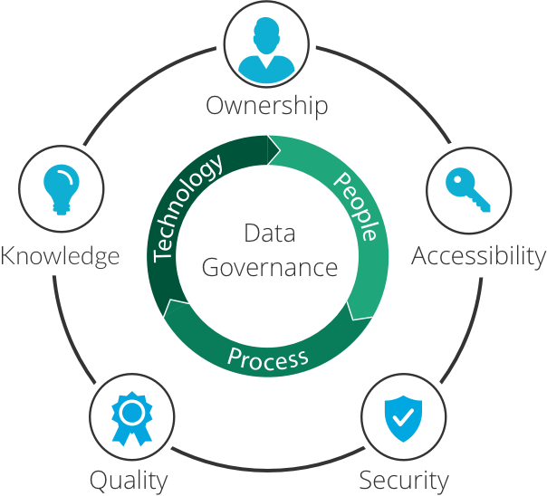
Conclusion
Finally, good governance requires balance and adjustment. If done properly it fuels innovation without compromising security which automatically helps in the betterment of the process. Ultimately, it’s all about the process, people, and technology. A successful program results in a clear understanding of where data comes from its owner. Together this process will provide data that depends on and strategic decisions and drive forward organization.

Slide 10

Our Team
Abdulrahman Mohammed Farag
Ahmed Mahmoud Abdel-Azim
Ahmed Ashraf Zidan
Nora Alaa Mahoumd
Hend Mahmoud Abu Elella
Aaron Loeb
Marketing Manager

Slide 11


Thank you for your attention!

